Slide 1


CUDA Lecture 9 Partitioning and Divide-and-Conquer Strategies
Prepared 8/19/2011 by T. O’Neil for 3460:677, Fall 2011, The University of Akron.

Slide 2
Overview
Partitioning: simply divides the problem into parts
Divide-and-Conquer:
Characterized by dividing the problem into sub-problems of same form as larger problem. Further divisions into still smaller sub-problems, usually done by recursion.
Recursive divide-and-conquer amenable to parallelization because separate processes can be used for divided parts. Also usually data is naturally localized.

Slide 3
Topic 1: Partitioning
Data partitioning/domain decomposition
Independent tasks apply same operation to different elements of a data set
Okay to perform operations concurrently
Functional decomposition
Independent tasks apply different operations to different data elements
Statements on each line can be performed concurrently
for (i=0; i<99; i++) a[i]=b[i]+c[i];
a = 2; b = 3; m = (a+b)/2; s = (a*a+b*b)/2; v = s*m*m;

Slide 4
Example: Data Clustering
Data mining: looking for meaningful patterns in large data sets
Data clustering: organizing a data set into clusters of “similar” items
Data clustering can speed retrieval of related items

Slide 5
High-Level Document Clustering Algorithm
Compute document vectors
Choose initial cluster centers
Repeat
Compute performance function
Adjust centers
until function value converges or the maximum number of iterations have elapsed
Output cluster centers

Slide 6
Data Parallelism Opportunities
Operations being applied to a data set
Examples
Generating document vectors
Finding closest center to each vector
Picking initial values of cluster centers

Slide 7
Functional Parallelism Opportunities
Build document vectors
Choose cluster centers
Do in parallel
Compute function value
Adjust cluster centers
Output cluster centers

Slide 8
Partitioning/Divide-and-Conquer Examples
Many possibilities:
Operations on sequences of numbers such as simply adding them together.
Several sorting algorithms can often be partitioned or constructed in a recursive fashion.
Numerical integration
N-body problem

Slide 9
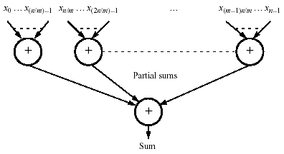
Example 1: Adding a Number Sequence
Partition sequence into parts and add them.

Slide 10
Outline of CUDA Solution
__global__ void add (int *numbers, int *part_sum) { int partialSum = 0, tid = threadIdx.x, s = n / blockDim.x; for (int i = tid * s; i < (tid + 1) * s; i++) partialSum += numbers[i]; part_sum[tid] = partialSum; __syncthreads(); } int main(void) { int numbers[n], part_sum[m], *dev_numbers, *dev_part_sum; cudaMalloc((void**)&dev_numbers, n * sizeof(int)); cudaMalloc((void**)&dev_part_sum, m * sizeof(int)); cudaMemcpy(dev_numbers, numbers, n * sizeof(int), cudaMemcpyHostToDevice); add<<<1, m>>>(dev_numbers, dev_part_sum); // 1 block, m threads cudaMemcpy(part_sum, dev_part_sum, m * sizeof(int), cudaMemcpyDeviceToHost); int sum = 0; for (int i = 0; i < m; i++) sum += part_sum[i]; cudaFree(dev_numbers); cudaFree(dev_part_sum); free(part_sum); }

Slide 11
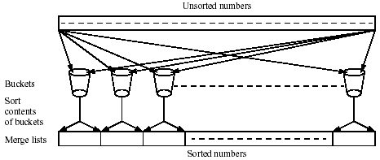
Example 2: Bucket sort
One “bucket” assigned to hold numbers that fall within each region.
Numbers in each bucket sorted using a sequential sorting algorithm.

Slide 12
Bucket sort (cont.)
Sequential sorting time complexity: O(n log ^{n}/_{m}) for n numbers divided into m parts.
Works well if the original numbers uniformly distributed across a known interval, say 0 to a-1.
Simple approach to parallelization: assign one processor for each bucket.

Slide 13
Example 3: Gravitational N-Body Problem
Finding positions and movements of bodies in space subject to gravitational forces from other bodies using Newtonian laws of physics.

Slide 14
Gravitational N-Body Problem (cont.)
Gravitational force F between two bodies of masses m_{a} and m_{b} is
G is the gravitational constant and r the distance between the bodies.

Slide 15
Gravitational N-Body Problem (cont.)
Subject to forces, body accelerates according to Newton’s second law: F = ma where m is mass of the body, F is force it experiences and a is the resultant acceleration.
Let the time interval be Δt. Let v^{t} be the velocity at time t. For a body of mass m the force is

Slide 16
Gravitational N-Body Problem (cont.)
New velocity then is
Over time interval Δt position changes by
where x^{t} is its position at time t.
Once bodies move to new positions, forces change and computation has to be repeated.

Slide 17
Sequential Code
Overall gravitational N-body computation can be described as
for (t = 0; t < tmax; t++) { /* ∀ time periods */ for (i = 0; i < N; i++) { /* for each body */ F = Force_routine(i); /* force on body i */ v[i]_{new} = v[i] + F * dt / m; /* new velocity */ x[i]_{new} = x[i] + v[i]_{new} * dt; /* new position */ } for (i = 0; i < N; i++) { /* for each body */ x[i] = x[i]_{new}; /* update velocity */ v[i] = v[i]_{new}; /* and position */ } }

Slide 18
Parallel Code
The sequential algorithm is an O(N²) algorithm (for one iteration) as each of the N bodies is influenced by each of the other N – 1 bodies.
Not feasible to use this direct algorithm for most interesting N-body problems where N is very large.
Time complexity can be reduced using observation that a cluster of distant bodies can be approximated as a single distant body of the total mass of the cluster sited at the center of mass of the cluster.

Slide 19
Barnes-Hut Algorithm
Start with whole space in which one cube contains the bodies (or particles).
First this cube is divided into eight subcubes.
If a subcube contains no particles, the subcube is deleted from further consideration.
If a subcube contains one body, subcube is retained.
If a subcube contains more than one body, it is recursively divided until every subcube contains one body.

Slide 20
Barnes-Hut Algorithm (cont.)
Creates an octtree – a tree with up to eight edges from each node.
The leaves represent cells each containing one body.
After the tree has been constructed, the total mass and center of mass of the subcube is stored at each node.
Force on each body obtained by traversing tree starting at root, stopping at a node when the clustering approximation can be used, e.g. when r ≥ d/θ where θ is a constant typically 1.0 or less.
Constructing tree requires a time of O(n log n), and so does computing all the forces, so that the overall time complexity of the method is O(n log n).

Slide 21
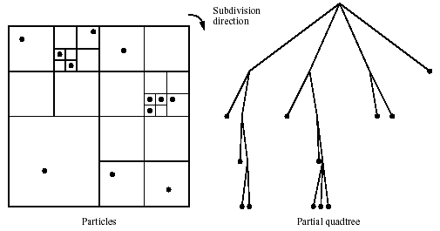
Recursive division of 2-dimensional space

Slide 22
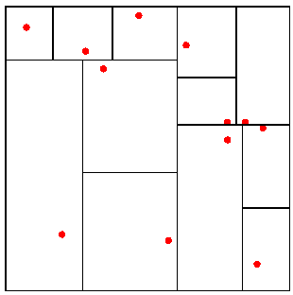
Orthogonal Recursive Bisection
(For 2-dimensional area) First a vertical line is found that divides area into two areas each with an equal number of bodies. For each area a horizontal line is found that divides it into two areas each with an equal number of bodies. Repeated as required.

Slide 23
Partitioning
Assume one task per particle
Task has particle’s position, velocity vector
Iteration
Get positions of all other particles
Compute new position, velocity

Slide 24
Final Example: Numerical Integration
Suppose we have a function ƒ which is continuous on [α,b] and differentiable on (α,b). We wish to approximate ∫ƒ(x)dx on [α,b].
This is a definite integral and so is the area under the curve of the function.
We simply estimate this area by simpler geometric objects.
The process is called numerical integration or numerical quadrature.

Slide 25
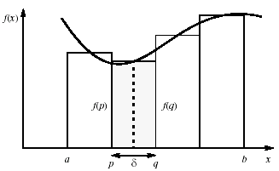
Numerical Integration Using Rectangles
Each region calculated using an approximation given by rectangles; aligning the rectangles:

Slide 26
Numerical Integration Using Rectangles (cont.)
The area of the rectangles is the length of the base times the height.
As we can see by the figure base = δ, while the height is the value of the function at the midpoint of p and q, i.e. height = ƒ(½(p+q)).
Since there are multiple rectangles, designate the endpoints by x₀ = α, x₁ = p, x₂ = q, x₃, …, x_{n} = b; Thus

Slide 27
Example : Calculating π
Can show that
Divide the interval [0,1] into the N subintervals
[^{i-1}/_{N},^{i}/_{N}] for i=1,2,3,…,N. Then

Slide 28
Simple CUDA program to compute π
#include <math.h> #include <stdio.h> __global__ void term (int *part_sum) { int n = blockDim.x; double int_size = 1.0/(double)n; int tid = threadIdx.x; double x = int_size * ((double)tid – 0.5); double partialSum = 4.0 / (1.0 + x * x); double temp_pi = int_size * part_sum; part_sum[tid] = temp_pi; __syncthreads(); }

Slide 29
Simple CUDA program to compute π (cont.)
int main(void) { double actual_pi = 3.141592653589793238462643; int n; double calc_pi = 0.0, *part_sum, *dev_part_sum; printf(“The pi calculator.\n”); printf(“No. intervals ”); scanf(“%d”, &n); if (n == 0) break; malloc((void**)&part_sum, n * sizeof(double)); cudaMalloc((void**)&dev_part_sum, n * sizeof(double)); term<<<1, n>>>(dev_part_sum); // 1 block, n threads cudaMemcpy(part_sum, dev_part_sum, n * sizeof(double), cudaMemcpyDeviceToHost); for (int i = 0; i < n; i++) calc_pi += part_sum[i]; cudaFree(dev_part_sum); free(part_sum); printf(“pi = %f\n”, calc_pi); printf(“Error = %f\n”, fabs(calc_pi – actual_pi)); }

Slide 30
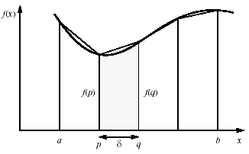
Numerical integration using trapezoidal method
May not be better!

Slide 31
Numerical integration using trapezoidal method (cont.)
The area of the trapezoid is the area of the triangle on top plus the area of the rectangle below.
For the rectangle, we can see by the figure that base = δ, while the height = ƒ(p); thus area = δ·ƒ(p).
For the triangle, base = δ while the height = ƒ(q) – ƒ(p), so area = ½·δ(ƒ(q) – ƒ(p)).
ƒ(p) |  | ƒ(q)
 | δ = q-p

Slide 32
Numerical integration using trapezoidal method (cont.)
Thus the total area of the trapezoid is ½·δ(ƒ(p)+ƒ(q)).
As before there are multiple trapezoids so designate the endpoints by x₀ = α, x₁ = p, x₂ = q, x₃, …, x_{n} = b.
Thus

Slide 33
Example : Calculating π
Returning to our previous example we see that

Slide 34
Example : Calculating π (cont.)
Comparing our methods
N | Rectangle Estimate | Trapezoid Estimate
1 | 3.200000 | 3.000000
10 | 3.142426 | 3.169926
100 | 3.141601 | 3.141876
1000 | 3.141593 | 3.141595
10,000 | 3.141593 | 3.141593

Slide 35
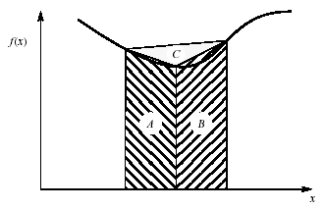
Adaptive Quadrature
Solution adapts to shape of curve. Use three areas A, B and C. Computation terminated when largest of A and B sufficiently close to sum of remaining two areas.

Slide 36
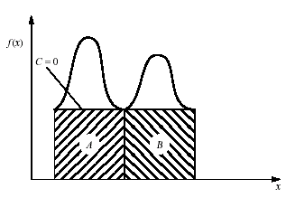
Adaptive quadrature with false termination
Some care might be needed in choosing when to terminate.
Might cause us to terminate early, as two large regions are the same (i.e. C=0).

Slide 37
Alternate Adaptive Quadrature Algorithm
For this example we consider an adaptive trapezoid method.
Let T(α,b) be the trapezoid calculation on [α,b], i.e.
T(α,b) = ½(b-α)(ƒ(α)+ƒ(b)).
Specify a level of tolerance ε > 0. Our algorithm is then:
Compute T(α,b) and T(α,m)+T(m,b) where m is the midpoint of [α,b], i.e. m = ½(α+b).
If | T(α,b) – [T(α,m)+T(m,b)] | < ε then use T(α,m)+T(m,b) as our estimate and stop.
Otherwise separately approximate T(α,m) and T(m,b) inductively with a tolerance of ½×ε.

Slide 38
Example
Clearly ∫√x dx over [0,1] is 2/3. Try to approximate this with a tolerance of 0.005.
In this case T(α,b) = ½(b – α)(√α + √b).
T(0,1) = 0.5, tolerance is 0.005.
T(0,½) + T(½,1) = 0.176777 + 0.426777 = 0.603553
|0.5 – 0.603553| = 0.103553; try again.
Estimate T(½,1) with tolerance 0.0025.
T(½,¾) + T(¾,1) = 0.196642 + 0.233253 = 0.429895
|0.426777 – 0.429895| = 0.003118; try again.

Slide 39
Example (cont.)
Estimate T(½, ¾) and T(¾,1) each with tolerance 0.00125.
T(½, ¾) = 0.196642.
T(½, ⁵⁄₈) + T(⁵⁄₈, ¾) = 0.093605 + 0.103537 = 0.197142.
|0.196642 – 0.197142| = 0.0005; done.
T(¾, 1) = 0.233253.
T(¾, ⁷⁄₈) + T(⁷⁄₈, 1) = 0.112590 + 0.120963 = 0.233553.
|0.233253 – 0.233553| = 0.0003; done.
Our revised estimate for T(½,1) is the sum of the revised estimates for T(½, ¾) and T(¾, 1).
Thus T(½,1) = 0.197142 + 0.233553 = 0.430695.

Slide 40
Example (cont.)
Now for T(0,½).
a | b | ε | m | T(a,b) | T(a,m) + T(m,b) | |diff|
1/4 | 1/2 | 0.00125 | 0.375 | 0.150888 | 0.151991 | 0.001102 | *
1/8 | 1/4 | 0.000625 | 0.1875 | 0.053347 | 0.053737 | 0.00039 | *
1/16 | 1/8 | 0.0003125 | 0.09375 | 0.018861 | 0.018999 | 0.000138 | *
1/32 | 1/16 | 0.00015625 | 0.046875 | 0.006668 | 0.006717 | 0.000049 | *
1/64 | 1/32 | 0.000078125 | 0.0234375 | 0.002358 | 0.002375 | 0.000017 | *
Subtotal |  |  |  |  | 0.233819

Slide 41
Example (cont.)
Still more for T(0,½).
a | b | ε ≈ | m ≈ | T(a,b) | T(a,m) + T(m,b) | |diff|
1/128 | 1/64 | 3.91E-05 | 0.011719 | 0.000834 | 0.00084 | 6.09E-06 | *
1/256 | 1/128 | 1.95E-05 | 0.005859 | 0.000295 | 0.000297 | 2.15E-06 | *
1/512 | 1/256 | 9.77E-06 | 0.00293 | 0.000104 | 0.000105 | 7.61E-07 | *
0 | 1/512 | 9.77E-06 | 0.000977 | 0.000043 | 0.000052 | 8.94E-06 | *
Subtotal |  |  |  |  | 0.001294
Total |  |  |  |  | 0.235113

Slide 42
Example (cont.)
So our final estimate for T(0,½) is 0.235113.
Our previous final estimate for T(½,1) was 0.430695.
Thus the final estimate for T(0,1) is the sum of those for T(0,½) and T(½,1) which is 0.665808.
The actual answer was 2/3 for an error of 0.0008586, well below our tolerance of 0.005.

Slide 43
Summary
Two strategies
Partitioning: simply divides the problem into parts
Divide-and-Conquer: divide the problem into sub-problems of same form as larger problem
Examples
Operations on sequences of numbers such as simply adding them together.
Several sorting algorithms can often be partitioned or constructed in a recursive fashion.
Numerical integration
N-body problem

Slide 44
End Credits
Based on original material from
The University of Akron: Tim O’Neil
The University of North Carolina at Charlotte
Barry Wilkinson, Michael Allen
Oregon State University: Michael Quinn
Revision history: last updated 8/19/2011.

